Slide 1
AWS Lambda Services

Slide 2
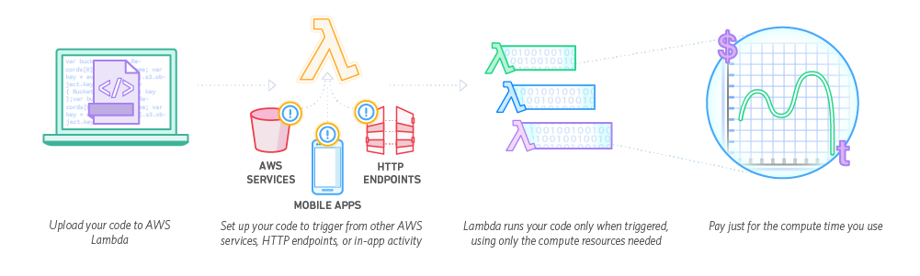
What is AWS Lambda?
AWS Lambda is a service that is offered by Amazon where it’s possible to run a coding project that works in tandem with other Amazon Cloud Services such as S3, DynamoDB, etc. It also allows for the running of code without the need for a server

Slide 3
What can it do?
There’s all sorts of practical applications for Lambda
Real-Time File Processing
Thumbnailing images, transcoding videos, indexing files, processing logs, etc.
Stream Processing
Social Media Trend data, transaction order processing, metrics generation, etc.
Data Warehousing
Back-End Systems
Web Applications
Serverless Applications

Slide 4
What goes into a Lambda function?
Lambda functions can be made in the 3 following languages
NODE.JS(JavaScript)
Java 8
Python
A Node.Js function just requires the source code and any Node.Js libraries that the function depends on all wrapped up in a zip file
A Java function is similar, but requires a bit more time and effort to actually build as you need to build a JAR file or a ZIP file through Maven
Python is relatively simple, since Lambda already includes AWS SDK for Python you only need to include your source code

Slide 5
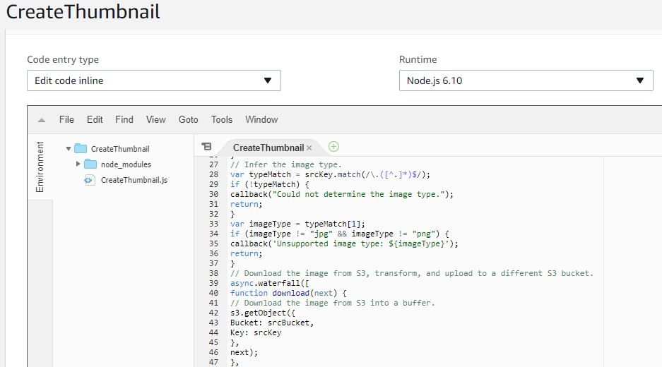
Is Any One Language Necessarily Better Than The Others?
This comes down entirely to personal preference and what you can handle.
Java Lambda functions can be rather large and unwieldy compared to Node.js and Python in my opinion. Not to mention Node.JS and Python functions can be edited while logged into the AWS management console allowing for quick code changes on the fly

Slide 6
The Project
For this project, I was asked to create a Lambda function which converted images in a S3 bucket into thumbnail-sized images.
To accomplish this, I created a Node.JS JavaScript function which creates a new image that is a resized version of any JPG or PNG that is added to the bucket. The bucket is hosted on my account, which a user with admin privileges is given access to.
The S3 bucket that contains the images to be transferred has an event handler attached to it, which runs the Lambda function whenever an object is added to the account

Slide 7
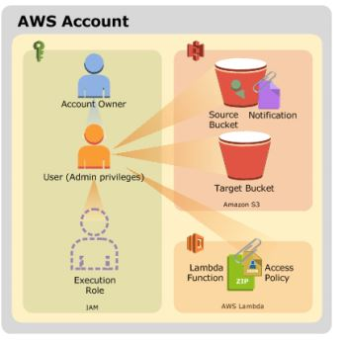
The Project Pt. 2

Slide 8


Comparing the image sizes
Original Image
Resized Image

Slide 9
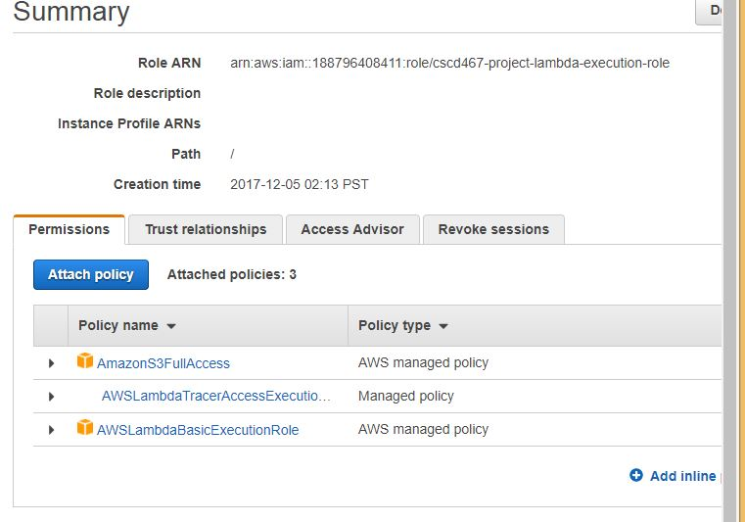
Problems with the Project
For some reason at the start, the Lambda function couldn’t access the S3 bucket whenever the ObjectCreated event fired.
To fix this, I added the AmazonS3FullAccess policy to the execution role

Slide 10
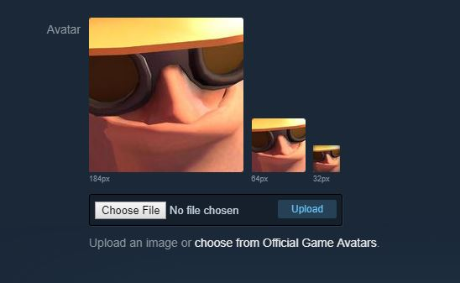
Applications of the Project
This function is very similar to how websites handle the creation of profile pictures, taking an image and resizing it so it can be used by the specific needs for the website

Slide 11
Applications Part 2
Not to mention, a program like this would make it easier to generate image sizes for various screen sizes (like tablets and mobile phones)

